Slide 1

SCOPE & APPROACH
DS-670-PHY: Capstone Project in Big Data & Business Analytics
Project plan and management for the selected topic: Disease State Conversation and Sentiment Analysis: Examination of Digital Community Conversations Within Specific Disease States Via Reddit ~Data Processing & Exploratory Data Analysis~

Slide 2

Week II: Assignment
Due 10/02/2021 – Slide Presentation: 9/29/2021
For the in class presentation 09/29 prepare your progress report, including tables, graphs, maps, pictures, code and other material relevant to the assignment.
Make sure to add captions to your graphical output and to draw the conclusions / insights into the next steps of your research.
Upload your homework assignment in Blackboard no later than Sunday midnight, 10/03.

Slide 3
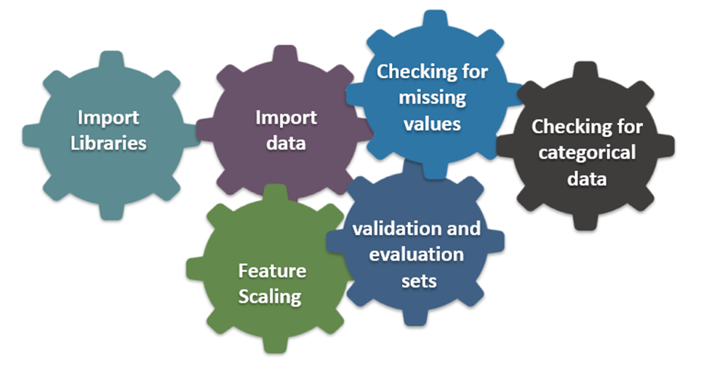
Introduction: What’s Next?
Why data processing for Reddit API?
Data processing involves converting the data into a more meaningful format which can help the machine learning or deep learning algorithms to perform better.
The following are the general steps involved:
Data Cleaning – Helps in removing inconsistent data and dealing with empty or null values
Data Integration – Involves combining data from different sources
Data Transformation – Data is transformed using different techniques like normalization, aggregation and generalization
The above mentioned steps can be achieved using different techniques like converting into lower case/ upper case, tokenization, removal of punctuations or special characters and stop words, stemming and lemmatization.
@Saint Peter’s University

Slide 4


Where Are We in the Project Lifecycle?
Answer
New Data/Re-training
Deployment
Business Problems
Data Processing
Data Collection
Data Preprocessing
Data Visualization
Data Augmentation
Feature Engineering
Etc.
Yes
Model
Training
Tuning
Evaluation
Etc.
Meets
Business
Goal?
ML Problem Formulation
No
@Saint Peter’s University

Slide 5


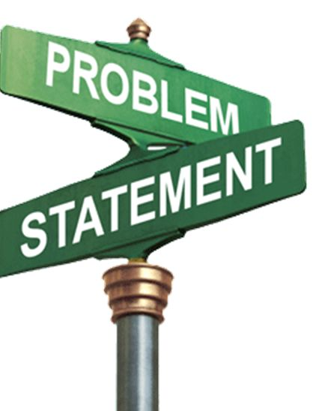




Summarized Problem Statement
Cognitive Service/ Text Analytics/ Sentiment Analysis/ Key Phrase Extraction
Deep Learning/Machine learning: - NLP -
PatientCom (Public Health Trend Collector): Hybrid Content-Based Collaborative Corpus Filtering Engine with Web Scraping and Sentiment Analysis
@Saint Peter’s University

Slide 6
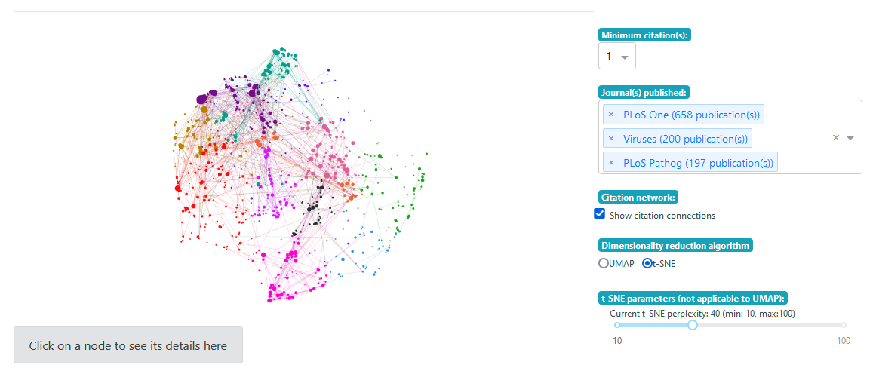
Vision
Problem type
Description
Final Plotly dash app
Topic Ranking
Helping users find the most trendy subjects on diseases
PatientCom (Public Health Trend Collector): Hybrid Content-Based Collaborative Corpus Filtering Engine with Web Scraping and Sentiment Analysis
Recommendation Engine
Giving users the thing they may be most interested in using NLP and LSTM
Class imbalance (Down Sampling)
Reduce the size of the dominant or frequent class(es).
Reddit Submission Corpus
publicly available Reddit submissions (42 GB)
Disambiguation of words
To understand public reaction we use LDA
Sentiment Analysis
Understand the users with Brandwatch's Sentiment Analysis Tool such as GPT-3
@Saint Peter’s University

Slide 7
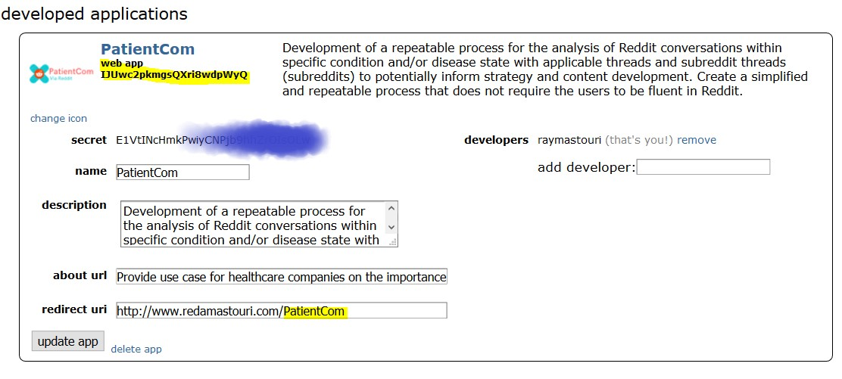
Data Set
Creating an app on Reddit Developer Account
Go to App Preferences and click create another app… at the bottom.
Fill out the required details, make sure to select script — and click create app.
NB: Let’s make a note of the personal use script and secret tokens
Request a temporary OAuth token from Reddit
Add headers=headers to every request.
Subscribing in most of the health related subreddits such as disease, breast cancer, prostate cancer, etc.

Slide 8
Methodology
What to implement at this stage:

Slide 9
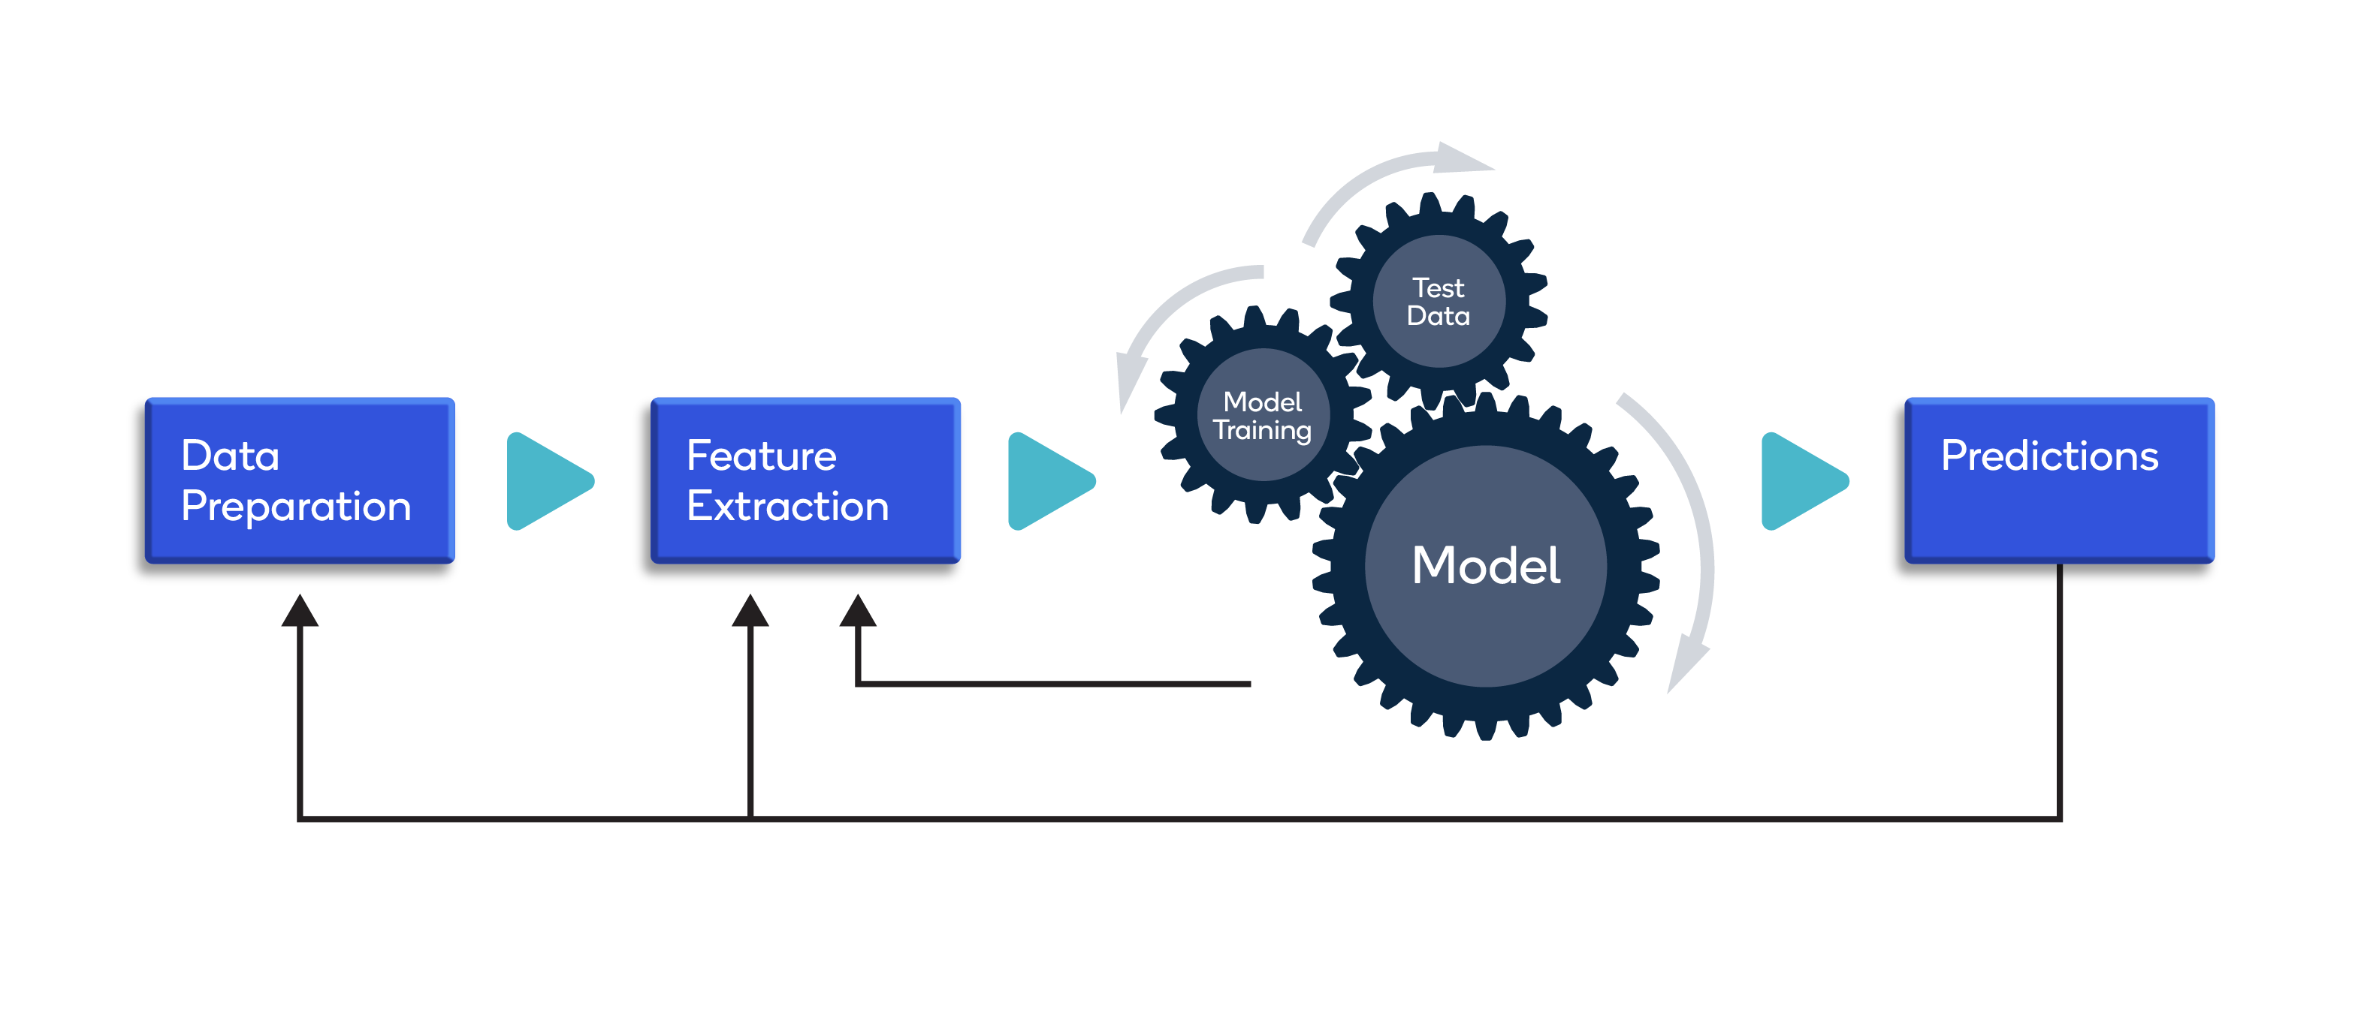
Data Preparation
Steps to data preparation:
As mentioned earlier, the following are the steps generally involved:
Loading the text
Tokenization – Splitting the text into tokens. Depending on the problem statement, token can be a word, sentence or a paragraph
Converting the word to a single format – lower case or upper case
Removing punctuations and special characters from the corpus
Removing stop words
Stemming and lemmatization – Convert a word to its root.

Slide 10
NLP & Text Processing
Token: Words or phrases extracted from documents. Splits text/document into small parts by white space and punctuation.
every
bike
electric
party
salad
early
work
next
like
come
part
sense
word
always
hard
doctor
tool
turn
time
me
code
land
time
smart
soft
home
pay
line
ball
science
piece
none
comedy
Feature vector: A numeric array that ML models use for different tasks such as training and prediction
ML models need well-defined numerical data.
foot
late
term
debt
lane
cake
go
dress
sense
sun
phone
cook
balance
cold
call
he
tech
equal
Text data
Text preprocessing
(Cleaning and formatting)
Vectorization
(Convert to numbers)
Train ML Model using numerical data
Stop words removal,
Stemming, Lemmatization
Bag of Words
K Nearest Neighbors (KNN),
Neural Network, etc.

Slide 11
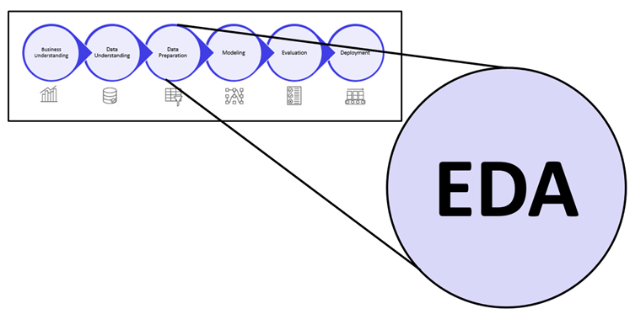
EDA Process
What’s EDA in Details
As the name suggests, Exploratory Data Analysis is the process of exploring data to gain insights and discover underlying patterns in data.
There is no standard procedure for EDA and it is generally problem-specific.
EDA typically involves descriptive statistics and visualizations.
Some common representations in the context of NLP are word clouds (help identify the most frequently occurring words), getting the polarity of the text etc.

Slide 12
Parsing & Spidering
What to opt for?
Parsing:
It is the process of determining the syntactic structure of a text by analysing its constituent words based on an underlying grammar (of the language).
The outcome of the parsing process would be a parse tree, where sentence is the root, intermediate nodes such as noun_phrase, verb_phrase etc. have children - hence they are called non-terminals and finally, the leaves of the tree such as the individual words in a sentence.
Spidering:
It is the process of indexing data on web pages by using a program or automated script. These automated scripts or programs are known by multiple names, including web crawler, spider, spider bot, and often shortened to crawler.
Web crawlers copy pages for processing by a search engine, which indexes the downloaded pages so that users can search more efficiently. The goal of a crawler is to learn what webpages are about. This enables users to retrieve any information on one or more pages when it’s needed

Slide 13
Tokenization
What to opt for?
Tokenization is essentially splitting a phrase, sentence, paragraph, or an entire text document into smaller units, such as individual words or terms. Each of these smaller units are called tokens
The tokens could be words, numbers or punctuation marks. In tokenization, smaller units are created by locating word boundaries.
These are the ending point of a word and the beginning of the next word. These tokens are considered as a first step for stemming and lemmatization

Slide 14
Stemming
Set of rules to slice a string to a substring that usually refers to a more general meaning.
The goal is to remove word affixes (particularly suffixes) such as “s”, “es”, “ing”, “ed”, etc.
“playing”
“played” “play”
”plays”
The issue: It doesn’t usually work with irregular forms such as irregular verbs: “taught”, “brought”, etc.

Slide 15
Lemmatization
What to opt for?
For grammatical reasons, documents are going to use different forms of a word, such as organize, organizes, and organizing. Additionally, there are families of derivationally related words with similar meanings, such as democracy, democratic, and democratization. In many situations, it seems as if it would be useful for a search for one of these words to return documents that contain another word in the set.
The goal of both stemming and lemmatization is to reduce inflectional forms and sometimes derivationally related forms of a word to a common base form. For instance: am, is, are => be
Lemmatization usually refers to doing things properly with the use of a vocabulary and morphological analysis of words, normally aiming to remove inflectional endings only and to return the base or dictionary form of a word, which is known as the lemma . If confronted with the token saw, stemming might return just s, whereas lemmatization would attempt to return either see or saw depending on whether the use of the token was as a verb or a noun.

Slide 16
Lemmatization – part 2
What to opt for?
Similar to stemming, but more advanced. It uses a look-up dictionary.
Handles more situations and usually works better than stemming.
“taught” -”am”
“teaching” “teach” -”is” “be”
“teaches” -“are”
For the best results, correct word position tags should be provided: “adjective”, “noun”, “verb” etc.

Slide 17
Sentence Splitting
What to opt for?
Sentence splitting is the process of dividing text into sentences.
A sentence splitter is also known as a sentence tokenizer, a sentence boundary detector, or a sentence boundary disambiguator.
It involves splitting documents into sentences via a set of rules.
Some example include using full stop(.), newline (/n) characters, considering the whole document as a sentence

Slide 18
String Normalization
What to opt for?
Text normalization is the process of transforming a text into a canonical (standard) form. For example, the word “gooood” and “gud” can be transformed to “good”, its canonical form. Another example is mapping of near identical words such as “stopwords”, “stop-words” and “stop words” to just “stopwords”.
Text normalization is important for noisy texts such as social media comments, text messages and comments to blog posts where abbreviations, misspellings and use of out-of-vocabulary words (oov) are prevalent.
Unfortunately, unlike stemming and lemmatization, there isn’t a standard way to normalize texts. It typically depends on the task. For example, the way you would normalize clinical texts would arguably be different from how you normalize sms text messages.

Slide 19
Text Vectorization
Bag of Words (BoW) & Term Frequency (TF)
Bag of Words method converts text data into numbers.
It does this by
Creating a vocabulary from the words in all documents
Calculating the occurrences of words:
binary (present or not)
word counts
frequencies
 | a | cat | dog | is | it | my | not | old | wolf
“It is a dog.” | 1 | 0 | 1 | 1 | 1 | 0 | 0 | 0 | 0
“my cat is old” | 0 | 1 | 0 | 1 | 0 | 1 | 0 | 1 | 0
“It is not a dog, it a is wolf.” | 2 | 0 | 1 | 2 | 2 | 0 | 1 | 0 | 1
 | a | cat | dog | is | it | my | not | old | wolf
“It is a dog.” | 0.25 | 0 | 0.25 | 0.25 | 0.25 | 0 | 0 | 0 | 0
“my cat is old” | 0 | 0.25 | 0 | 0.25 | 0 | 0.25 | 0 | 0.25 | 0
“It is not a dog, it a is wolf.” | 0.22 | 0 | 0.11 | 0.22 | 0.22 | 0 | 0.11 | 0 | 0.11
Term frequency (TF): Increases the weight for common words in a document.
$tf(term, doc)$= $\frac{number of times the term occurs in the doc}{total number of terms in the doc}$

Slide 20
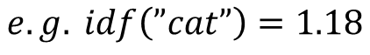
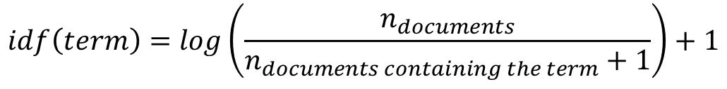
Text Vectorization
Inverse Document Frequency (IDF) & TF-IDF
term | idf
a | log(3/3)+1=1
cat | log(3/2)+1=1.18
dog | log(3/3)+1=1
is | log(3/4)+1=0.87
it | log(3/3)+1=1
my | log(3/2)+1=1.18
not | log(3/2)+1=1.18
old | log(3/2)+1=1.18
wolf | log(3/2)+1=1.18
Inverse document frequency (IDF): Decreases the weights for commonly used words and increases weights for rare words in the vocabulary.
Term Freq. Inverse Doc. Freq (TF-IDF): Combines term frequency and inverse document frequency.
$$tf_{idf}(term,doc)=tf\left(term, doc\right)∗idf(term)$$
$$idf\left(term\right)=\log\left(\frac{n_{documents}}{n_{documents containing the term}+1}\right)+1$$
 | a | cat | dog | is | it | my | not | old | wolf
“It is a dog.” | 0.25 | 0 | 0.25 | 0.22 | 0.25 | 0 | 0 | 0 | 0
“my cat is old” | 0 | 0.3 | 0 | 0.22 | 0 | 0.3 | 0 | 0.3 | 0
“It is not a dog, it a is wolf.” | 0.22 | 0 | 0.11 | 0.19 | 0.22 | 0 | 0.13 | 0 | 0.13
$$e.g. idf\left(”cat”\right)=1.18$$

Slide 21
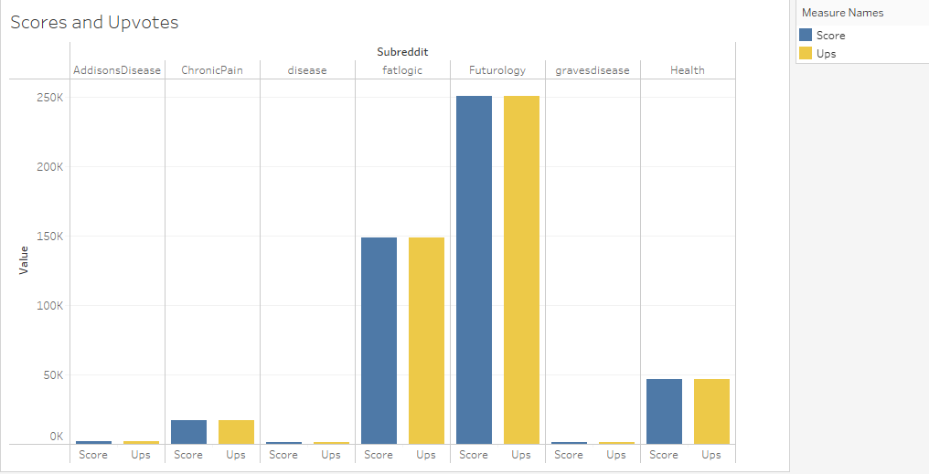
Tableau: Data Visualization (Part I)

Slide 22
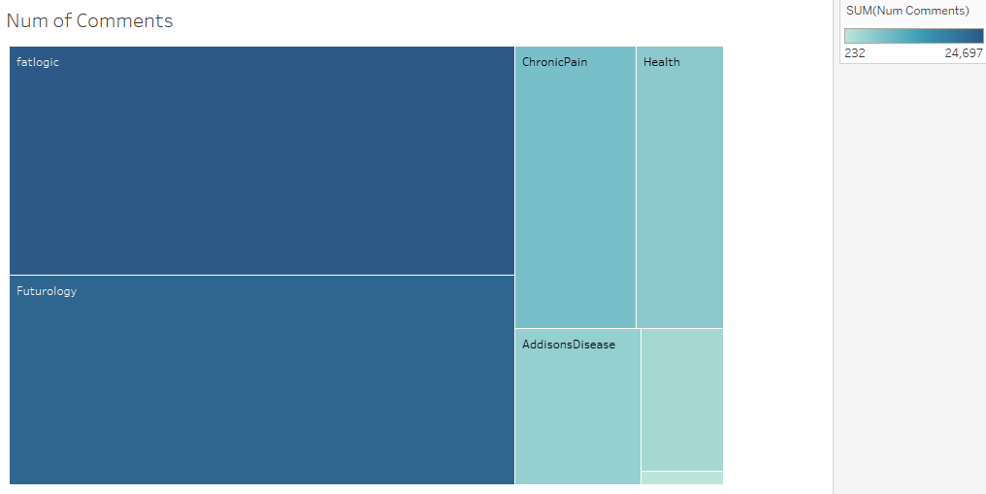
Tableau: Data Visualization (Part II)

Slide 23
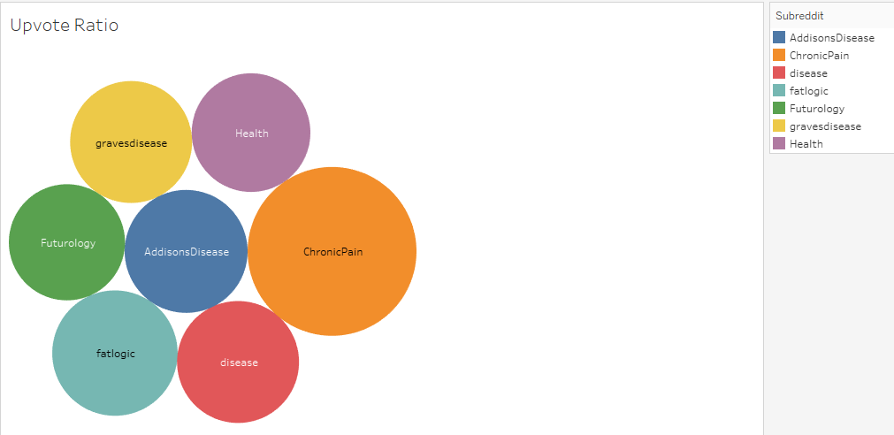
Tableau: Data Visualization (Part III)

Slide 24
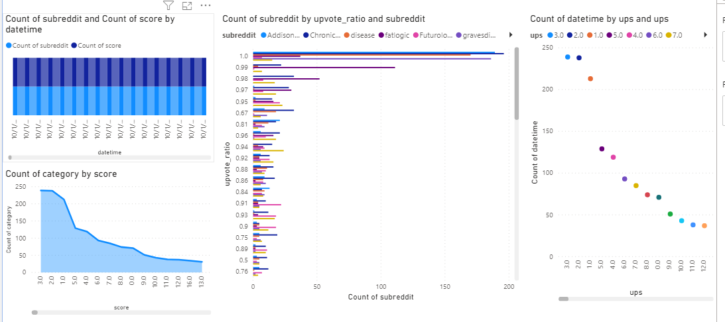
PowerBI: Data Visualization

Slide 25
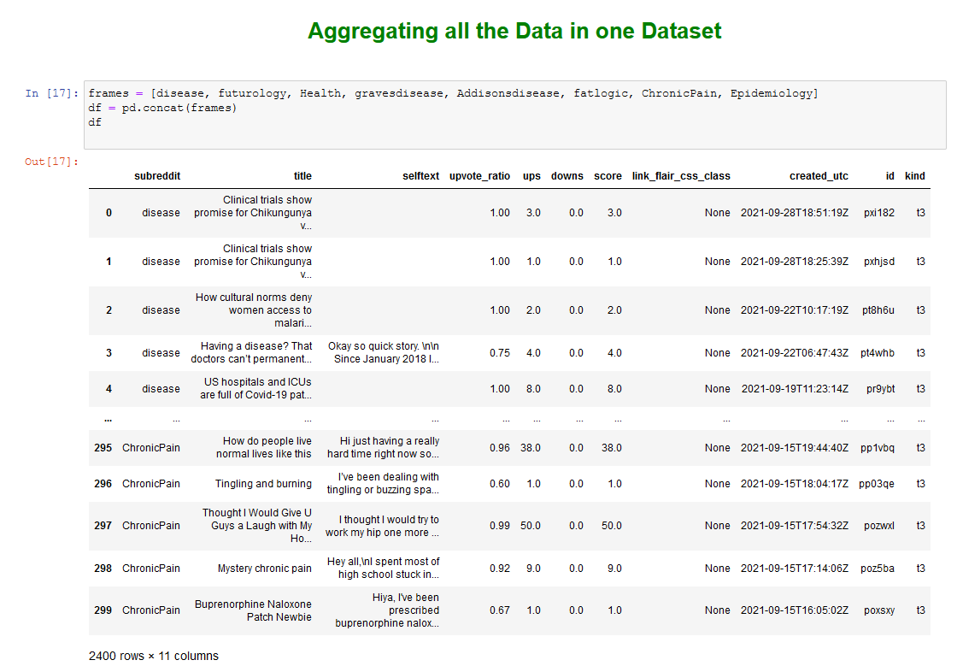
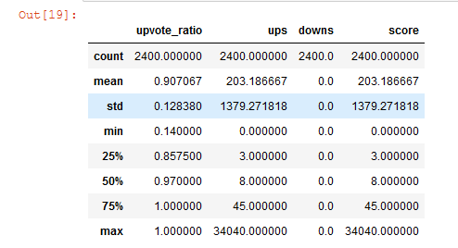
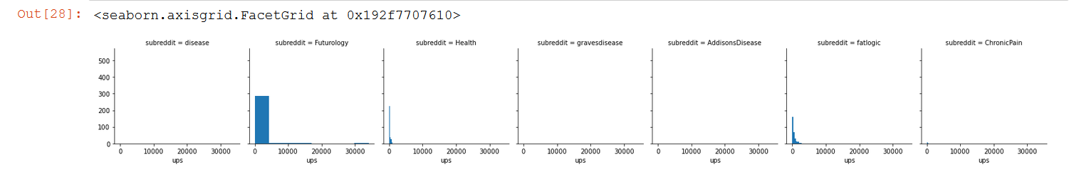
Data Set on Python Jupyter Notebook
EDA of the Reddit App

Slide 26

Conclusion and Insights
What we have learnt
The Reddit API makes it extremely easy to compile a lot of news data fairly quickly. It's definitely worth the time and effort to enhance the data collection steps since it's so simple to get thousands of rows of disease opinions to use for further analysis and prediction.
There's still a lot that could be engineered in regards to data mining, and there's still a lot to do with the data retrieved. The next step we will continue our analysis by merging to live-feed dataset to construct and train a recommendation engine.

Slide 27
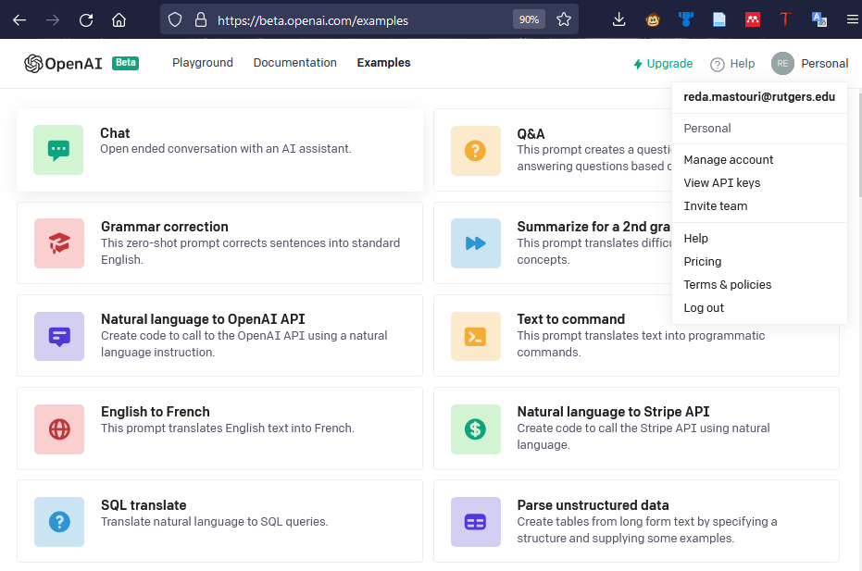

Next Step
Modeling: LSTM, LDA
Implementing the openAI GPT-3 API for advanced sentiment analysis

Slide 28


+ 1 (856) 882-9056
+ 1 (201) 985-4032
rmastouri@saintpeters.edu
kpavuluri@saintpeters.edu
https://www.linkedin.com/in/reda-mastouri/
https://www.linkedin.com/in/kalyani-pavuluri-30416519
THANK YOU!

